Slide 1
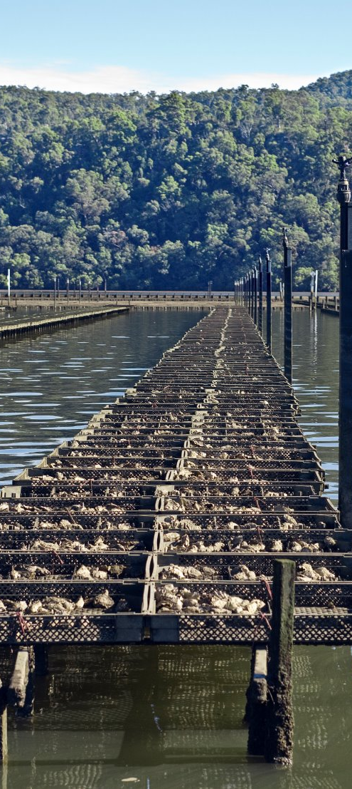
What we do (and don’t) know about QX in NSW
Liana Bonner and Dr Jeffrey Go
Aquatic Biosecurity, Department of Primary Industries and Regional Development
04 September 2024

Slide 2
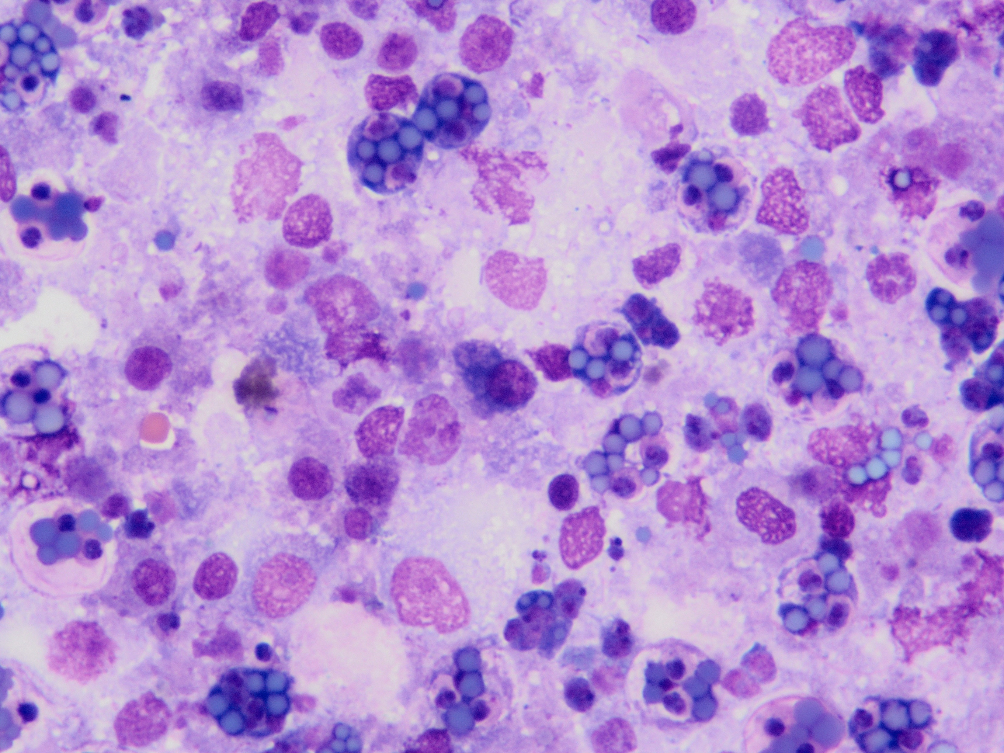
What is QX?
QX stands for Queensland Unknown
Seen in Queensland & New South Wales
First diagnosed in NSW in Tweed River and Richmond River in 1975
The causative agent is Marteilia sydneyi, a single celled parasite (protozoa)
Only affects Sydney Rock Oysters
Related to Marteilia refringens which infects flat oysters
Strain variation unknown
Notes:
QX disease were first observed in oysters in Queensland in the 1960s when the cause of disease was unknown hence called Queensland unknown. We now know the cause of the disease is a single celled parasite called Marteilia sydneyi. This parasite is seen here as the purple spheres or spores which are replicating inside the pink oysters cells.

Slide 3
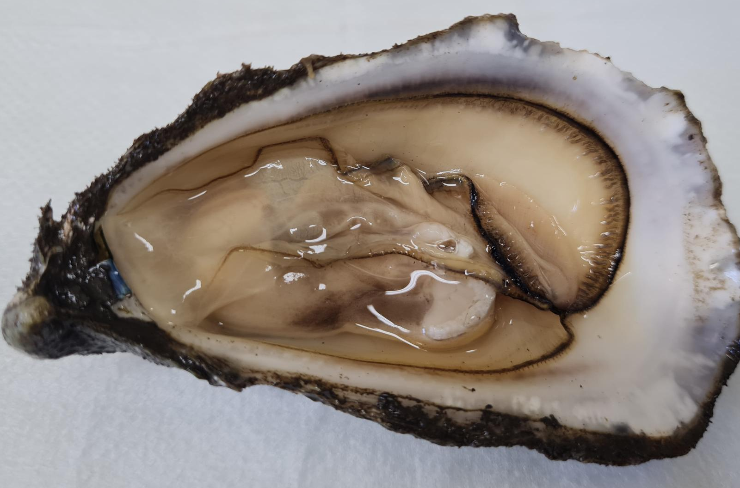
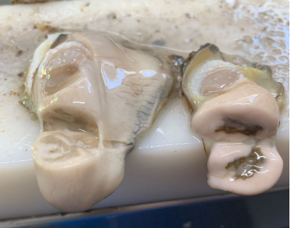
Disease
Marteilia sydneyi are filtered from the water through the gills & palps
Spread through the haemolymph (oyster blood)
No QX disease until M. sydneyi sporulates in the digestive gland
Digestive gland becomes pale
Poor condition - shrunken, watery body
Colourless and translucent tissue as the gonad is resorbed
Mortality rate highly variable
Oyster losses usually occur in autumn or winter
Dr. Pedro Pinczowski
Notes:
The parasite are filtered in through the gills and palps of the oyster and spread through the oyster blood known as haemolymph. In the digestive gland the parasite replicates also known as sporulates in the digestive gland. As the spores rupture through the oysters gut it can no longer process food and the oyster begins to starve. In an effort to conserve energy the gonads are resorbed, leaving a shrunken, watery oyster which is less appealing and profitable. The shells begin to gape and up to 100% stock mortality can occur. Whilst we believe the infection happens in the period from January to April, mortality occurs between Autumn and Winter.

Slide 4
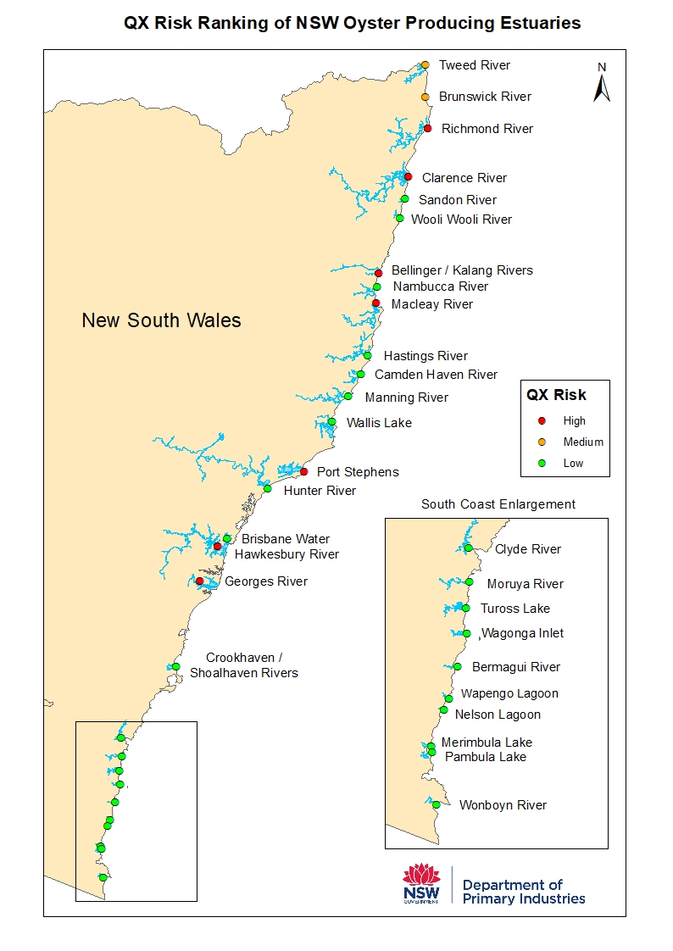
Distribution
QX Risk Ranking
  High Risk: 7 estuaries
  Medium Risk: 2 estuaries
  Low Risk: 20 estuaries
Research from 2003 demonstrated DNA fragments of M. sydneyi in estuaries which have never shown signs of disease (including some low risk estuaries)
What we do (and don't) know about QX in NSW
Notes:
Qx outbreak occurred in Port Stephens in 2021, which at the time was the estuary which produced the 2nd most Sydney rock oysters in the state (Aquaculture Production Report 2021).
The NSW Biosecurity Regulation has categorised estuaries in the state based on the level of risk of oysters in the area acquiring QX. This is aimed at preventing parasite spread and ensuring the success of our Sydney Rock Oyster industry. The highest rated estuaries are Richmond River, Clarence River, Bellinger River, Macleay river, Port Stephens, Hawkesbury river and the Georges River.
There are two medium rated estuaries – the Tweed River and Brunswick River.
There are 20 estuaries are categorised as low risk as there has been no evidence of Qx disease in oysters in these estuaries.
However In 2003 some research based on an old non specific PCR detected Marteilia sydneyii DNA in almost all oyster growing estuaries of NSW. Important to note that no sporulating parasites were found ?

Slide 5


Disease Spread
Evidence of the parasite in estuaries does not always cause disease
Not directly transmissible
Notes:
Whilst there is some DNA evidence of the parasite in many NSW estuaries, we know that actual QX disease Is only present in some estuaries. We also know through experimental infection in a lab environment you can’t spread QX directly from oyster to oyster.

Slide 6

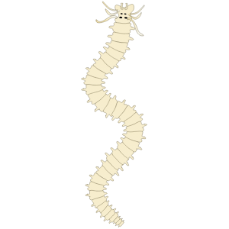
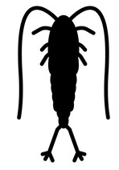
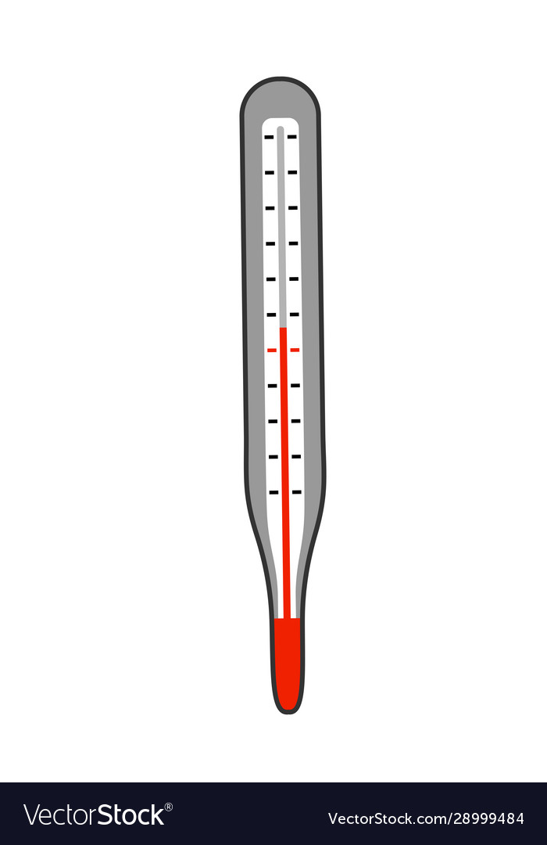

Disease Spread
Vectors?
Environment?
Host?
Notes:
So what causes the parasite to spread? If we know what causes it to spread hopefully we are able to stop Qx disease.
If transmission isn’t direct there must be a vectors or change in environment or host that causes the oyster to become more susceptible to the parasite causing disease (something that is yet to be replicated in a lab environment).
A lot of research has occurred investigating these factors and potentially a combination of factors that lead to disease. These include environmental changes such as changes in the water temperature or salinity. A potential vector so another aquatic invertebrate. Or does the host need to be immunocompromised first.

Slide 7
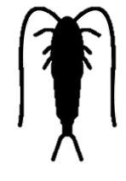
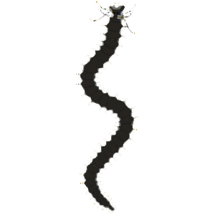

Potential Vectors? (Intermediate Hosts)
Plankton
2 positives
?
Jellyfish
2 weak positives
Polychaete worms
0 positives
Notes:
2024 data from surveillance (not lab experiments)

Slide 8
Previous QX Window of Infection Studies
Analysis of the Hawkesbury region in the 2005/06 to 2008/09 seasons demonstrated that for QX in the Hawkesbury River:
        infection period is between 8 and 18 weeks
        start of infection is highly variable but occurred after a drop in salinity to 10ppt
        end of infection seems more predictable and occurs after a drop in water temperature
        infections didn't occur at water temperature less than 21.5°C
Notes:
Looking at the potential impact of the environment on Qx disease a lot of research has gone into determining a window of infection which is a period of time where the seasonal conditions encourage parasite spread and we see subsequent oyster death. There has been limited research on WOIs however the first in NSW was done in the Hawkesbury River. This was completed between 2005 and 2009 and found some great preliminary results. These include . . .

Slide 9
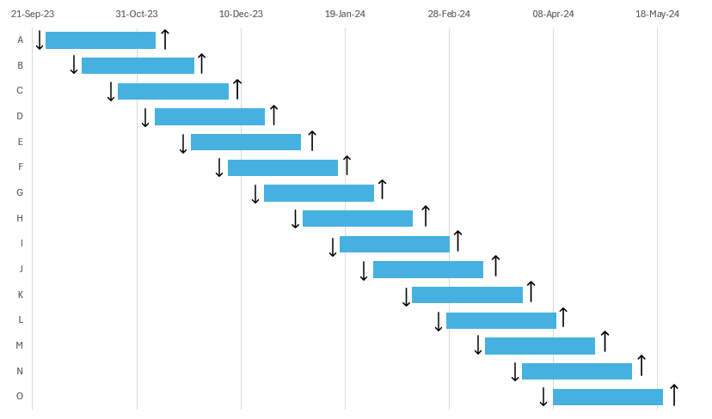

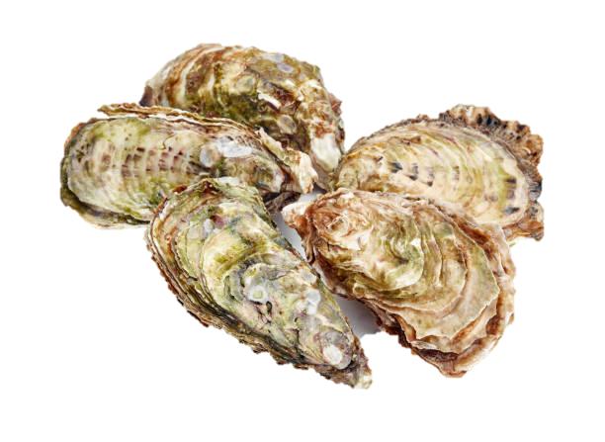
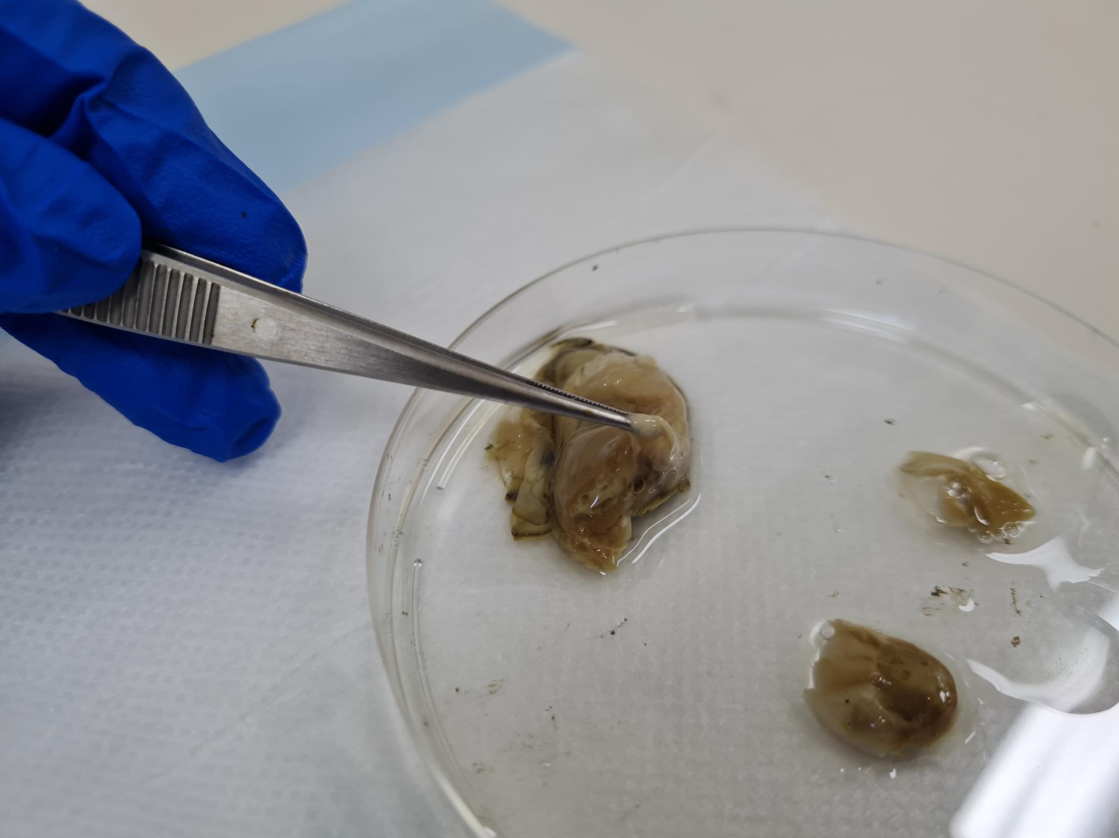


Window of Infection – study design
35
Notes:
Our study design is based upon similar work already completed in the Hawkesbury however this time focused in Port Stephens which was the estuary which produced the 2nd most Sydney rock oysters in the state prior to its 2021 disease outbreak.
NSW DPIRD started our work in Port Stephens in 2022 focusing on the sites hardest hit by QX disease. The diagram demonstrates our sampling plan from the 2023 to 2024 season.
From the 26th of September, 35 Naïve oysters were deployed every two weeks as demonstrated by the down arrow on the diagram.
We continued to place oysters in the water every two weeks, with each batch of oysters staying in the water for a period of six weeks at which time they were taken out as demonstrated by the up arrow. We continued this until the last batch of oysters were taken out in May. Immediately after removal from the water the oysters were taken to the laboratory at EMAI where they were dissected and tested via PCR as well as cytology.

Slide 10
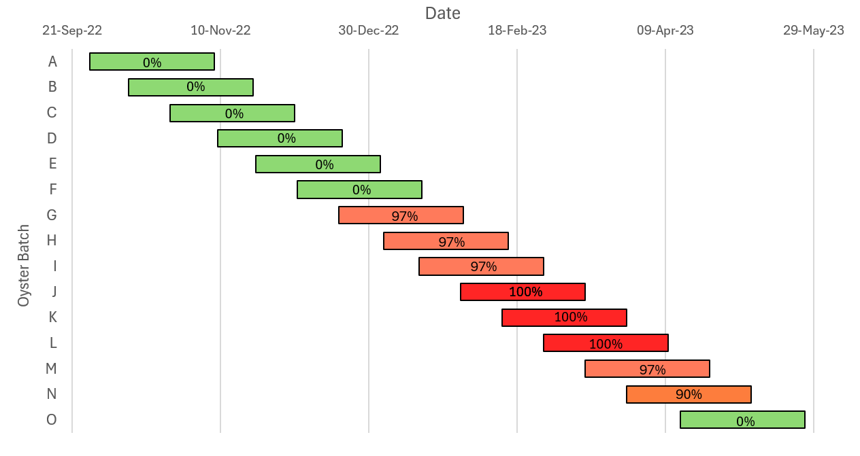

Karuah 2022-23 Season
Legend
PCR Positive
10%
90%
90%
Cytology Positive
73%
%
80%
70%
43%
13%
Notes:
Here I’ve got our results from one of our oyster deployment sites at Karuah for the 2022 to 2023 season.
Each bar demonstrates a separate batch of oysters, with the number of QX PCR positive oysters represented as a percentage on each one. The circles demonstrate the number of sporulating QX seen on histology, which is the defining requirement of disease
We can see the maximum positive samples for a single batch was 100%, however only 90% of all oysters sampled were sporulating.
Looking seasonally we can see that the oysters placed in the water in spring are ok. However oysters in the water during summer and the start of Autumn tested positive for QX.

Slide 11
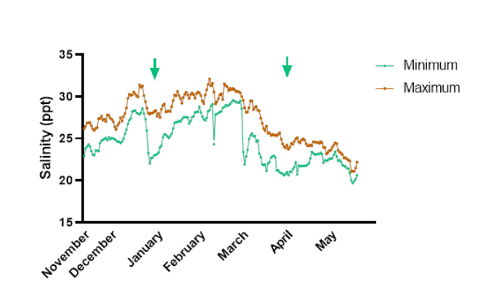
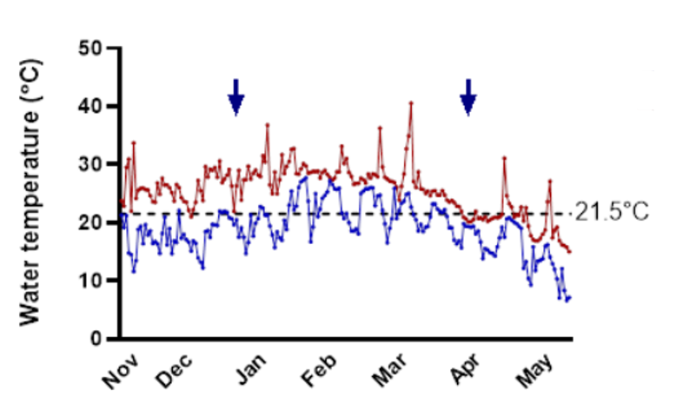
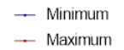
Water temperature & Salinity
Notes:
Comparing this oyster data to the water temperature data for the year we can see that during summer the minimum water temperature was almost always above 21.5C. Minimum water temperatures dropped below 21.5C during Autumn coinciding with the negative results from the oysters deployed during this time.

Slide 12
Some of the Key Findings
A drop in salinity is important for the opening of the QX window
Minimum water temperature below 21.5°C appears to be important, particularly for the closing of the QX window
Positive results vary between years and location of Oysters
Potential that not all PCR positive oysters are sporulating as shown through differences in cytology results
You can keep up to date with our results on the DPI website which we update regularly

Slide 13
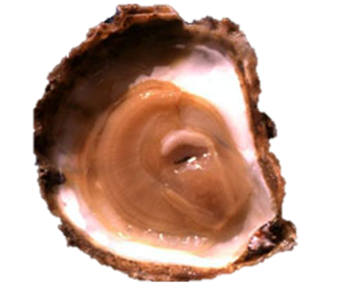
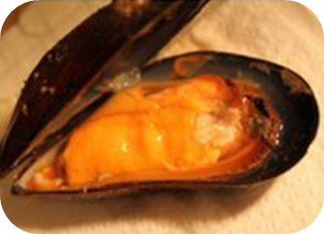
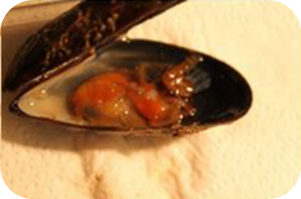
Molecular typing – Marteilia spp.
M. refringens - Flat oysters
M. pararefringens - Mussels
Healthy
Sick
Image source: French Research Institute for Exploitation of the Sea-IFREMER​
Image source: Anders Alfjordan. https://www.mpi.govt.nz/biosecurity/pests-and-diseases-not-in-new-zealand/ocean-pests-and-diseases-not-in-nz/marteiliosis/​
Is a similar situation in NSW a possible explanation for M. 'sydneyi' polymerase chain reaction (PCR) positives in earlier studies?

Slide 14
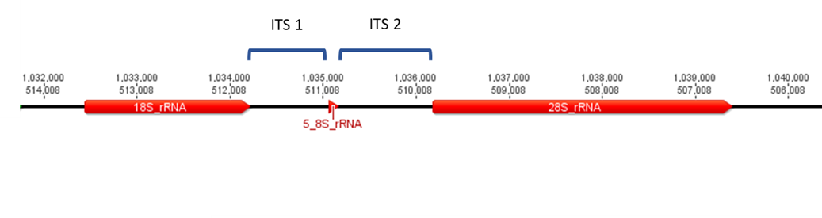
Molecular typing: objectives and design
Primary objective:
        Compare sequence from PCR positives from estuaries without QX disease to those with recurring QX
      Secondary objective:
        Compare sequence data from estuaries with recurrent QX with estuaries with sporadic QX
      Design:
        Sample and test from estuaries without QX from those previously identified as having high PCR positive prevalence for M. sydneyi
        Generate sequence data from samples from different QX affected estuaries archived at EMAI

Slide 15
Molecular typing: results to date
Wild & Cultivated Sydney Rock Oyster sampling
 | 2023 | 2024 | TOTAL
Wallis Lake | 150 | 250 | 400
Wagonga Inlet | - | 250 | 250
Tuross Lake | - | 250 | 250
TOTAL | 150 | 750 | 900
No evidence of M. sydneyi detected in any of those samples
Samples from archival material shows no major sequence data differences – all consistent with a single species

Slide 16
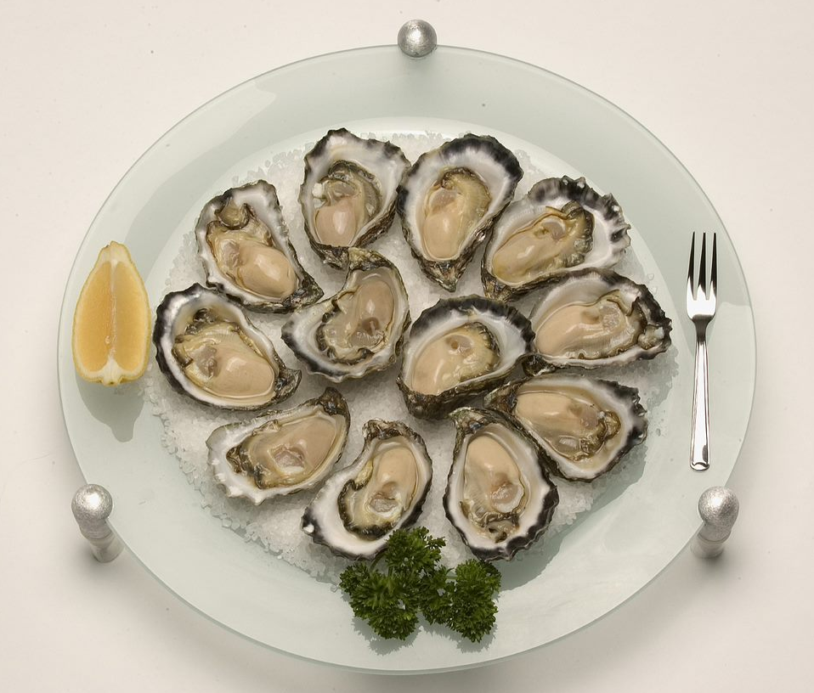
Conclusions and significance – what does this all mean and why does it matter?
Window of infection
        Critical minimum temperature for infection seems consistent with previous data from the Hawkesbury
        Potential options for "window farming" to reduce exposure of stock by deploying after window closes
Identification of potential alternate hosts
        Potential to assist with development of management strategies to further minimise risk
Regulatory implications?
        Widespread single pathogen found across all NSW estuaries vs
        Pathogen only found where QX is detected

Slide 17


Acknowledgements
Thank you to
        Fisheries Research and Development Corporation (FRDC)
        NSW DPIRD Aquaculture Trust
        NSW Oyster Industry
        NSW Department of Primary Industries and Regional Development
        NSW DPIRD Elizabeth Macarthur Agricultural Institute (EMAI)

